Slide 1
UNEARTHING THE ENVIRONMENTAL IMPACT OF HUMAN ACTIVITY : A GLOBAL CO2 EMISSION ANALYSYS

Slide 2
TEAM MEMBERS
TEAM LEADER
SAMEERA TAJ F
PERSON 1
KALAIYARASI V
PERSON 2
KAVIYA R
PERSON 3
LOKESHWARI V

Slide 3
I-INTRODUTION

Slide 4
1.1 OVERVIEW
Global Warming is one of the biggest challenges currently being faced by the Human race, although correlation is not causation, a likely cause of global warming is due to increased atmospheric carbondioxide from human activity.

Slide 5

1.2 PURPOSE OF CO2 EMISSION
1
Fossile fuel use is the primary source of Co2.
3
For this analysis we will be focusing on Co2 Emission and its effect on the world we live in as well as some key factors that may play a role in the emission of Co2 globally.
2
The data throws light onto how much fossil fuel are burnt, per year per nation, Which amounts to an increase in Co2 every year.

Slide 6
Ii-PROBLEM DEFINITION & DESIGN THINKING

Slide 7
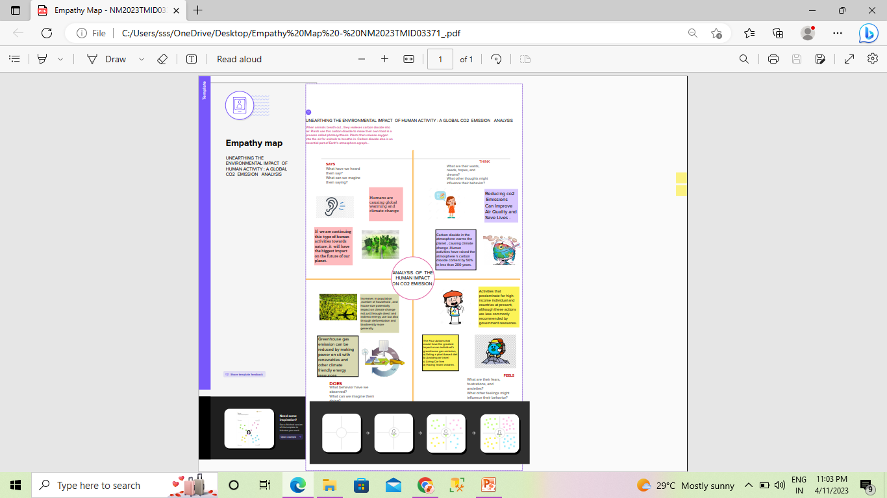
2.1 EMPATHY MAP

Slide 8
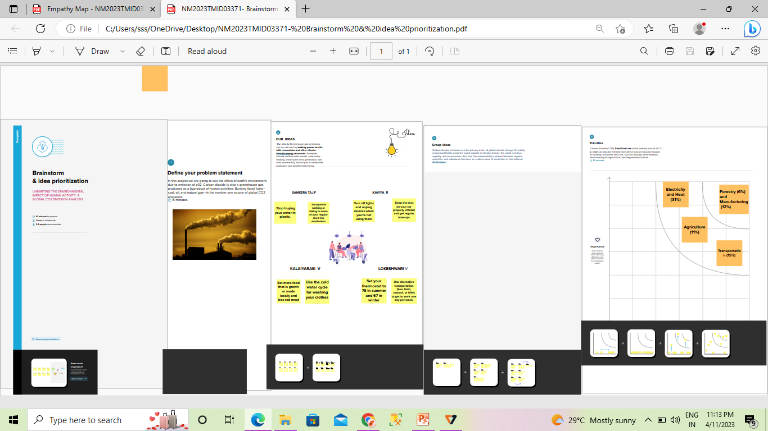
2.2 IDEATION & BRAINSTROMING MAP SCREENSHOTS

Slide 9
III-RESULTS

Slide 10
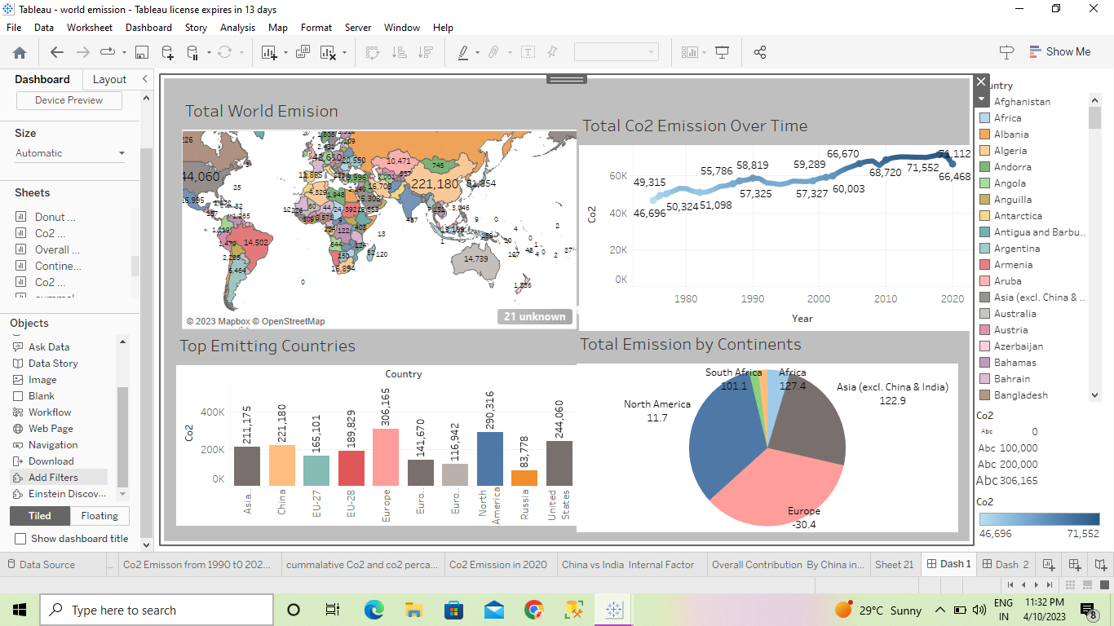
3.1 DASHBOARD- I

Slide 11
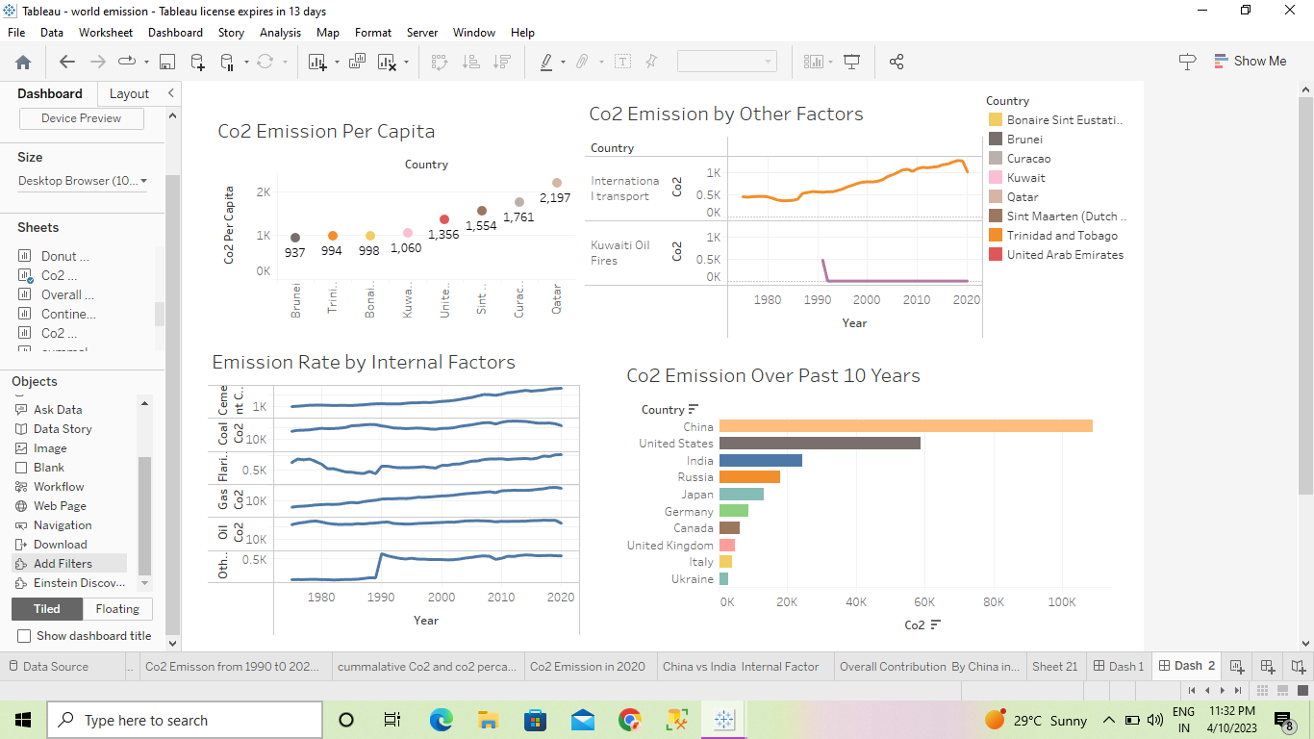
3.2 DASHBOARD-II

Slide 12
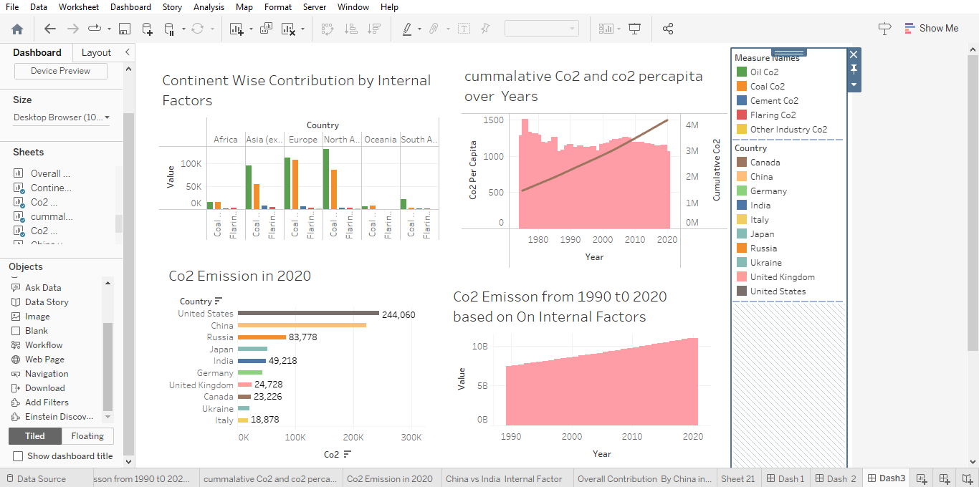
3.3 DASHBOARD -III

Slide 13
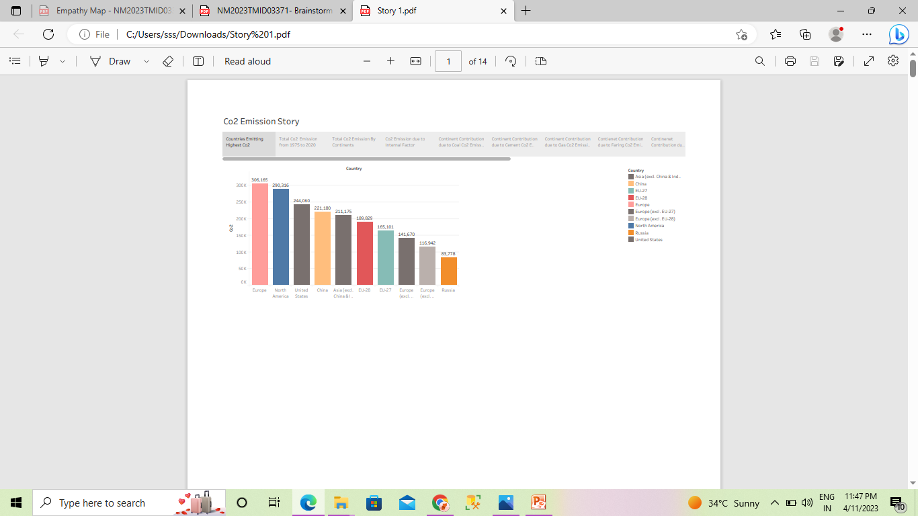
3.4 STORY

Slide 14
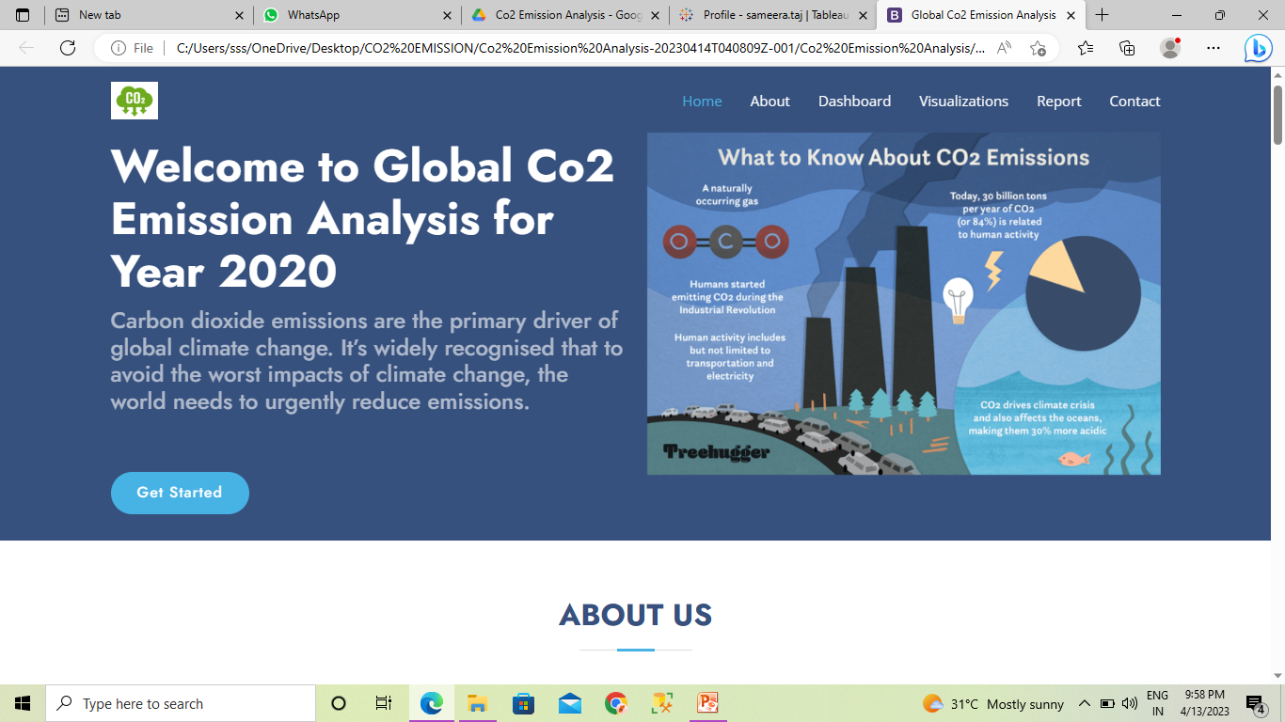
3.5 WEB INTEGRATION

Slide 15
IV- ADVANTAGES AND DISADVANTAGES OF GLOBAL
CO2 EMISSION

Slide 16
ADVANTAGES OF GLOBAL CO2 EMISSION
Greenhouse gases keep our planet liveable by holding onto some of Earth’s heat energy so that it does not all escape into space.
Removes the need for Co2 piping to transport the gas to underground storage sites.
01
03
Reducing co-emitted air pollutants improves air quality and benefits human health.
02
04
Allows the use of renewable energy and optimal storage sites.

Slide 17
DISADVANTAGE OF GLOBAL CO2 EMISSION
Carbon dioxide gas can be toxic and very harmful to humans, it increases the temperature of the Earth’s atmosphere .
01
03
Global Warming that threatens the existence of life on this planet, a high concentration of Carbon dioxide gas causes narcosis
Increasing the percentage of Carbon di oxide gas in the air causes suffocation of living organisms.
Co2 gas level increases to higher than 5% in the room , this ratio is enough to kill human being.
02
04

Slide 18
APPLICATION OF GLOBAL CO2 EMISSION
In This project we will see the Analysis of Global Co2 Emission by human activity in the world.
New pathway to use Co2 in the production of fuels, chemical and building materials are generating global interest.
The market for Co2 use will likely remain relatively
small in the short term, but early opportunities
can be cultivated .

Slide 19
APPLICATION OF GLOBAL Co2 EMISSION
(CONTD…)
Globally, some 230 million tonnes (Mt) of co2 are used every year .
New pathways involve transforming Co2 into fuels, chemicals and building materials.
The production od Co2-based fuels and Chemicals is energy -intensive and requires large amount s of Hydrogen.
Co2 could be an important raw material for products that require carbon.

Slide 20
V CONCLUTION

Slide 21
Based on the data we used in the report and the exploratory data analysis process that has been done, we conclude that:
TOTAL WORLD EMISSION
Based on the Total world Emission, Europe is the region that is the top most Co2 emission country in the world between the years 1970 to 2020.
TOTAL CO2 EMISSION OVER TIME
Depending on the co2 emission over time delineate, 2018 is the year that is the top most co2 emitting year.
CO2 EMISSION PER CAPITA
In the graph of Co2 emission per capita, Qatar is most emitting co2 in the world

Slide 22
CO2 EMISSION BY INTERNATIONAL FACTORS
Oil co2 is the highest Co2 emission comparing with the other emission in the graph.
EMISSION RATE OVER 10 YEARS
However china has the mass of discharge of co2 in this analysis of the delineate .
CO2 CONTRIBUTION BY DIFFERENT FOSSIL FUEL
Contingent on the chart of this Coal is the dominant CO2 emission source.
CHANGE IN CO2 EMISSION AND CO2 EMISSION IN 2020
Global Carbon dioxide emission fell by 6.4%, or 2.3 billion tonnes in 2020.

Slide 23
VI
FUTURE SCOPE

Slide 24
Continued emission of greenhouse gases will lead to further climate changes.
Future changes are expected to include a warmer atmosphere, a warmer and more acidic ocean , higher sea levels, and larger changes in precipitation patterns.
The more we emit, the larger future changes will be.

Slide 25
Greenhouse gas concentration in the atmosphere will continue to increase unless the billion of tons of our annual emission decrease substantially, Increased concentration are expected to, which is given by

Slide 26


ICE
Reduce ice and snow cover, as well as permafrost
TEMPEATURE
Increase Earth’s average temperature

Slide 27
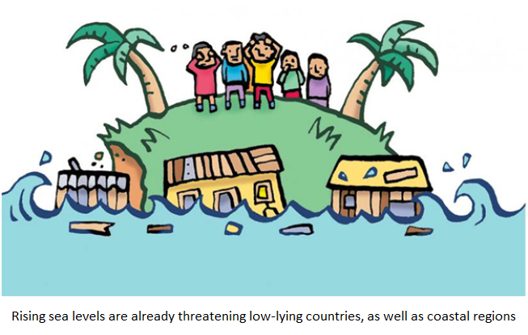
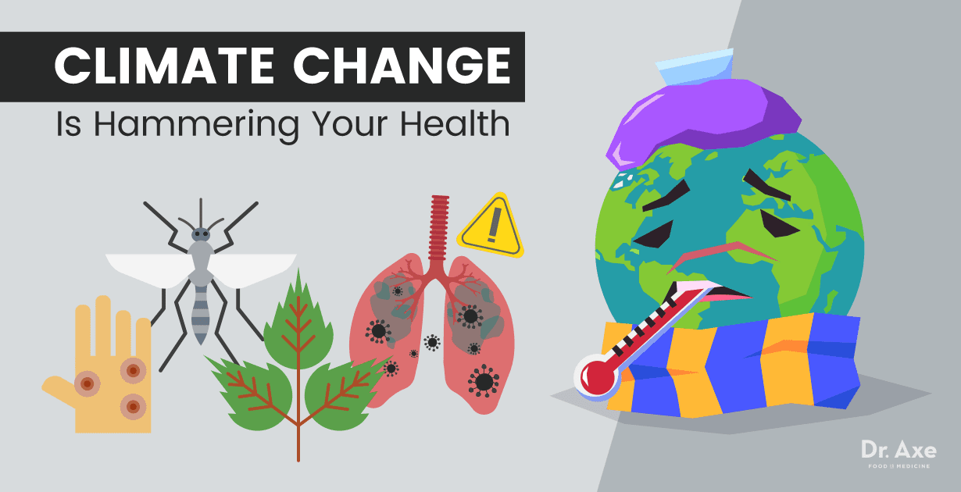
HUMAN HEALTH
Increase threats to human health
SEA LEVEL
Raise sea level

Slide 28
THANK YOU

